Slide 1

💻 Laptop Market Analysis
(End-to-End Data Analytics Project)
Name - Aravind Marikanti
Batch.No - 539

Slide 2
About me :
Background:
Bachelor of Technology (B.Tech) in Electronics and Communication Engineering (ECE) . Graduated with a strong foundation in analytical thinking, problem-solving, and programming concepts.
Why I Want to Learn Data Science:
Passionate about working with data to uncover meaningful insights and support data-driven decision-making. Looking to enhance my technical skills and build a successful career as a Data Scientist.
Work Experience:
                Data Analyst at Survey Sampling International (SSI)
Cleaned, validated, and transformed data to tables to ensure accuracy and consistency for reporting.
LinkedIn and GitHub profile URLs
LinkedIn: https://www.linkedin.com/in/aravind155
GitHub: https://github.com/Aravind25Marikanti/Laptop-Market-Analysis-EDA_End-to-End-Data-Analytics-Project-

Slide 3
Agenda :
Introduction
Business Problem Statement
Project Objective
Website Selection & Data Source
Web Scraping Methodology
Technologies & Libraries Used
Data Collection Process
Raw Dataset Overview
Data Cleaning & Preprocessing
Final Dataset Overview
Exploratory Data Analysis (EDA)
Key Analysis Questions (Use Cases)
Visualization Analysis
Business Insights & Recommendations
Conclusion
Challenges
Future Improvements
Thank You

Slide 4
Introduction
This project focuses on analyzing laptop data collected through web scraping.
The dataset contains information such as brand, processor, RAM, storage, display, and price.
Python is used for data extraction, cleaning, and feature extraction.
The analysis helps identify laptop specifications, pricing patterns, and market trends.
Core Focus
Approach: scrape → clean → analyze → visualize → derive busines insights

Slide 5
Business Problem Statement
The laptop market offers a wide range of products with different specifications and prices.
Comparing these products manually can be time-consuming and difficult.
Customers and retailers need meaningful insights to understand which specifications offer better value.
Therefore, there is a need to analyze laptop data and identify relationships between specifications and pricing.

Slide 6
Project Objective
To collect laptop data through web scraping.
To clean and transform the scraped data for analysis.
To extract important features such as processor, RAM, storage, display, and price.
To analyze pricing patterns and specification trends.
To generate insights that support better laptop comparison and purchasing decisions.

Slide 7
Website Selection & Data Source
Data Source: Flipkart – Laptop Category
Reason for Selection: Wide range of laptops with detailed specifications and prices
Data Collection Method: Web Scraping using Python
Data Collected: Brand, Model, Processor, RAM, Storage, Display, Price & Features
Output: Scraped data stored in a CSV file for analysis

Slide 8
Web Scraping Methodology
Used Requests to send HTTP requests to Flipkart listing pages.
Used BeautifulSoup to parse and extract data from HTML content.
Used headers where required to simulate browser-like requests.
Dynamically changed page URLs to collect data from multiple pages.
Collected product-level details into Python lists.
Converted the collected data into a Pandas DataFrame for further processing.
Methodology Flow
Flipkart → Requests → BeautifulSoup → Extract Data → Multiple Pages → Pandas DataFrame

Slide 9
Technologies & Libraries Used
Programming Language
Python - Data collection, cleaning and processing
Data Processing
Pandas - Data Handling
NumPy - Numerical operations
Web Scraping Libraries
Requests - Sending HTTP requests
BeautifulSoup (bs4) - Parsing HTML and extracting data
Data Visualization
Matplotlib, Seaborn - Visualization
Data Extraction & Cleaning
Regular Expressions (re) - Extracting specific information

Slide 10
Data Collection Process
Selected the Laptop category on Flipkart as the data source.
Identified the required product-level fields to collect.
Sent requests to the laptop listing pages using Python.
Extracted product details from the HTML content using BeautifulSoup.
Dynamically accessed pages 1–41 to collect multiple products.
Combined 984 collected records with 8 raw columns into a Pandas DataFrame.
Saved the raw scraped data as scrapped_data.csv for further processing.

Slide 11
Raw Dataset Overview
Raw Column | Purpose
Product Name | Laptop product title
Price | Current selling price
Original Price | Original/list price when available
Discount | Discount percentage
Rating | Product rating
Reviews | Ratings/review information
Features | Combined specifications
Page Number | Source listing page
Source: Flipkart Laptop Listings
Records: 984 laptop products
Columns: 8 raw columns
Format: CSV (scrapped_data.csv)

Slide 12
Data Cleaning & Preprocessing
Extracted Brand from product names.
Extracted Processor, RAM, SSD and Display using Regular Expressions.
Converted Price to numeric rupee values and Discount to percentage values.
Removed 426 duplicate rows.
Removed 8 rows with missing Price because price was essential for price analysis.
Kept legitimate missing SSD, Display, Discount and Rating values rather than inserting unsupported values.
Checked statistical outliers and retained valid premium/high-capacity products.

Slide 13
Final Dataset Overview
Column | Meaning | Non-null
Brand | Laptop brand | 550
Processor | Processor type | 550
RAM_gb | RAM capacity in GB | 550
SSD_gb | SSD capacity in GB | 524
Display_cm | Display size in cm | 546
Price_rupee | Laptop price in rupees | 550
Discount_pct | Discount percentage | 439
Rating | Product rating | 457
984
Rows of Raw Data
558
Rows after duplicates
550
After removing NANs of Price
550
Final rows
8
Final columns

Slide 14
Exploratory Data Analysis (EDA)
Univariate analysis: Brand, Processor, RAM and SSD distributions.
Bivariate analysis: Brand/Processor/RAM/SSD compared with laptop price.
Multivariate analysis: Brand + RAM + SSD combinations compared with price.
Premium segment analysis: laptops priced above ₹1,00,000.
Visualizations were created to communicate the major patterns.

Slide 15
Key Analysis Questions (Use Cases)
1. Which brands have the highest number of laptops?
2. Which processor types are most commonly available?
3. How are laptops distributed across RAM capacities?
4. How are laptops distributed across SSD capacities?
5. Which brands offer the most expensive laptops on average?
6. Does higher RAM correspond to higher laptop prices?
7. Does higher SSD capacity correspond to higher laptop prices?
8. Which processors are associated with higher average laptop prices?
9. What Brand + RAM + SSD combinations are associated with premium pricing?
10. Which brands dominate the premium laptop segment?

Slide 16
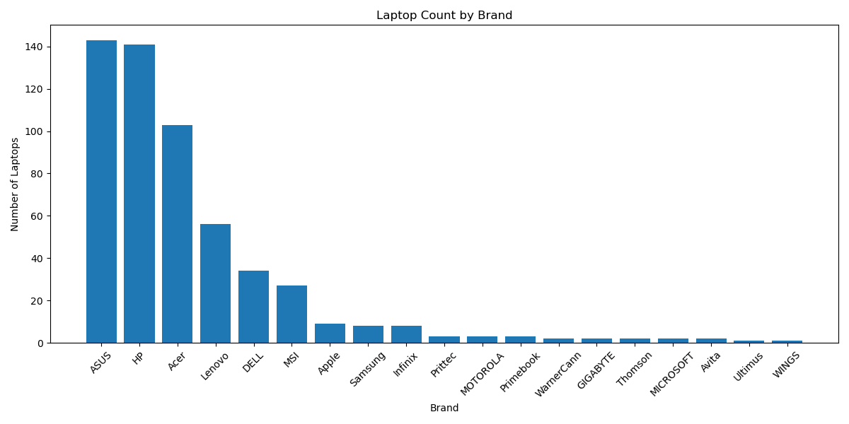
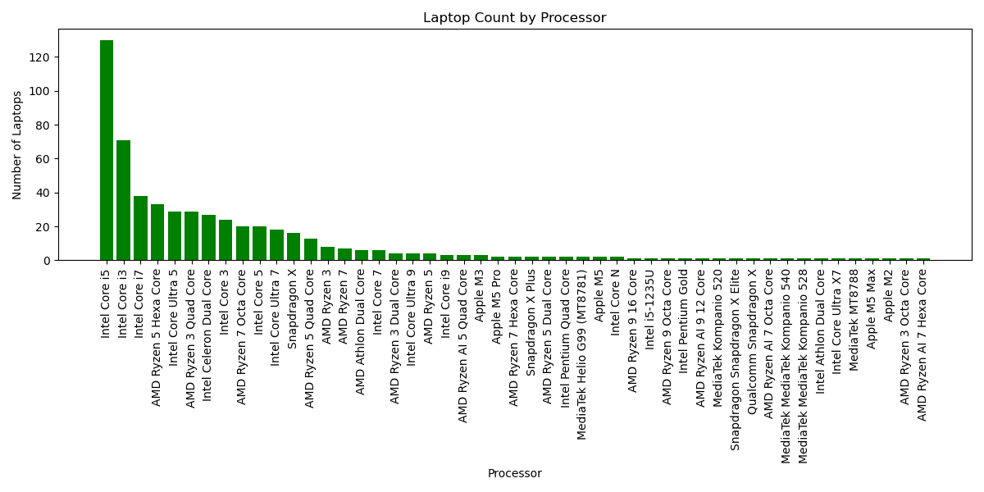
Visualization Analysis
1. Brand Distribution
2. Processor Distribution
Observations of: 1. The scraped laptop market is highly concentrated among ASUS(143), HP(141), and Acer(103), while the remaining brands have considerably fewer listings.
2.The dataset is strongly dominated by Intel processors, particularly the Core i5, Core i3, and Core i7 series.

Slide 17
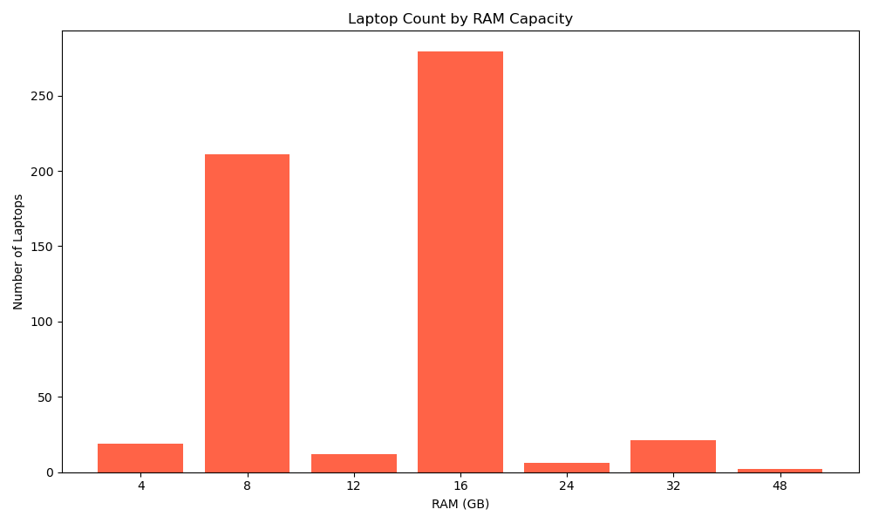
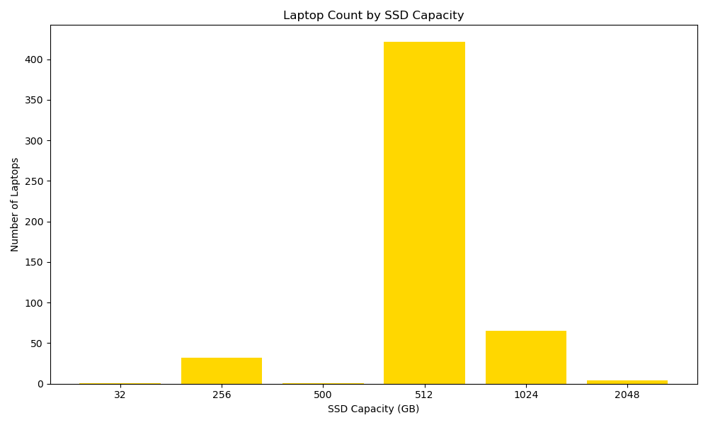
3. RAM Distribution
4. SSD Distribution
Observation of 3:The dataset is mainly concentrated around 8 GB and 16 GB RAM, with 16 GB being the dominant configuration. Higher capacities such as 32 GB and 48 GB are relatively uncommon.
Observation of 4:The dataset is strongly concentrated around 512 GB SSD, while higher capacities such as 1 TB and 2 TB have relatively fewer listings. Lower capacities such as 32 GB and 500 GB are rarely available.

Slide 18
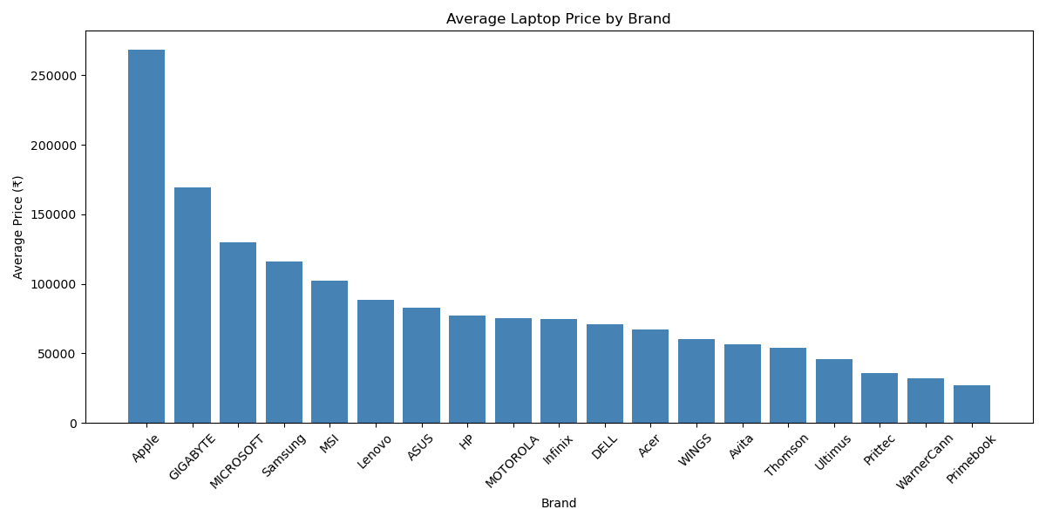
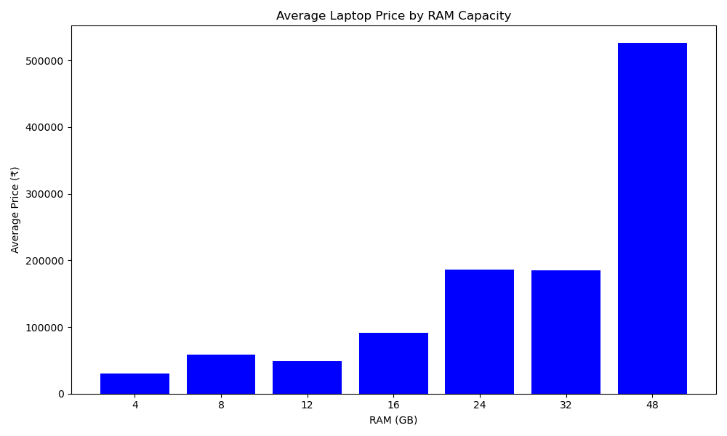
5. Average Price by Brand
6. Average Price by RAM
Observation of 5: Apple stands out with a significantly higher average price than other brands, while GIGABYTE and MICROSOFT also have relatively high average prices. Brands such as Primebook, WarnerCann, and Prittec have much lower average prices.
Observation of 6: Higher RAM configurations are generally associated with higher average laptop prices. The 48 GB category has a particularly high average price, while 4 GB and 8 GB laptops have much lower average prices.

Slide 19
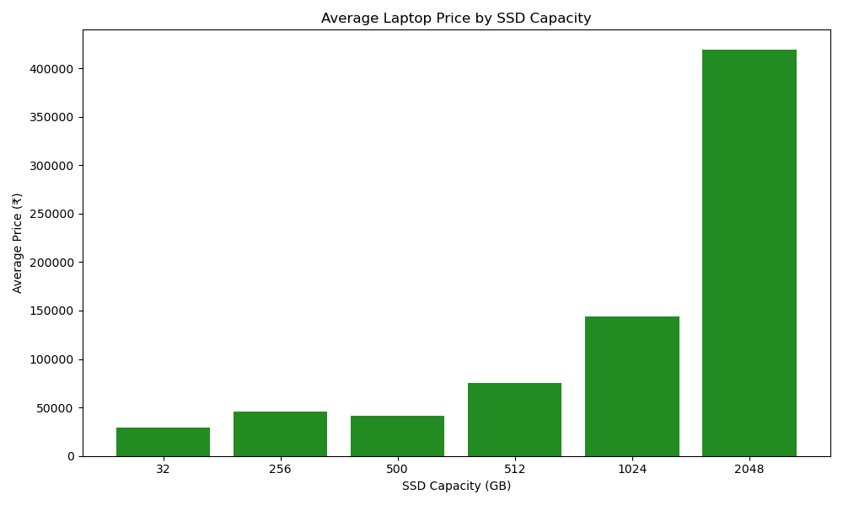
7. Average Price by SSD
Observation of 7: The average laptop price generally increases as SSD capacity increases. The 2 TB category has a particularly high average price, while 256 GB and 32 GB laptops have much lower average prices.

Slide 20
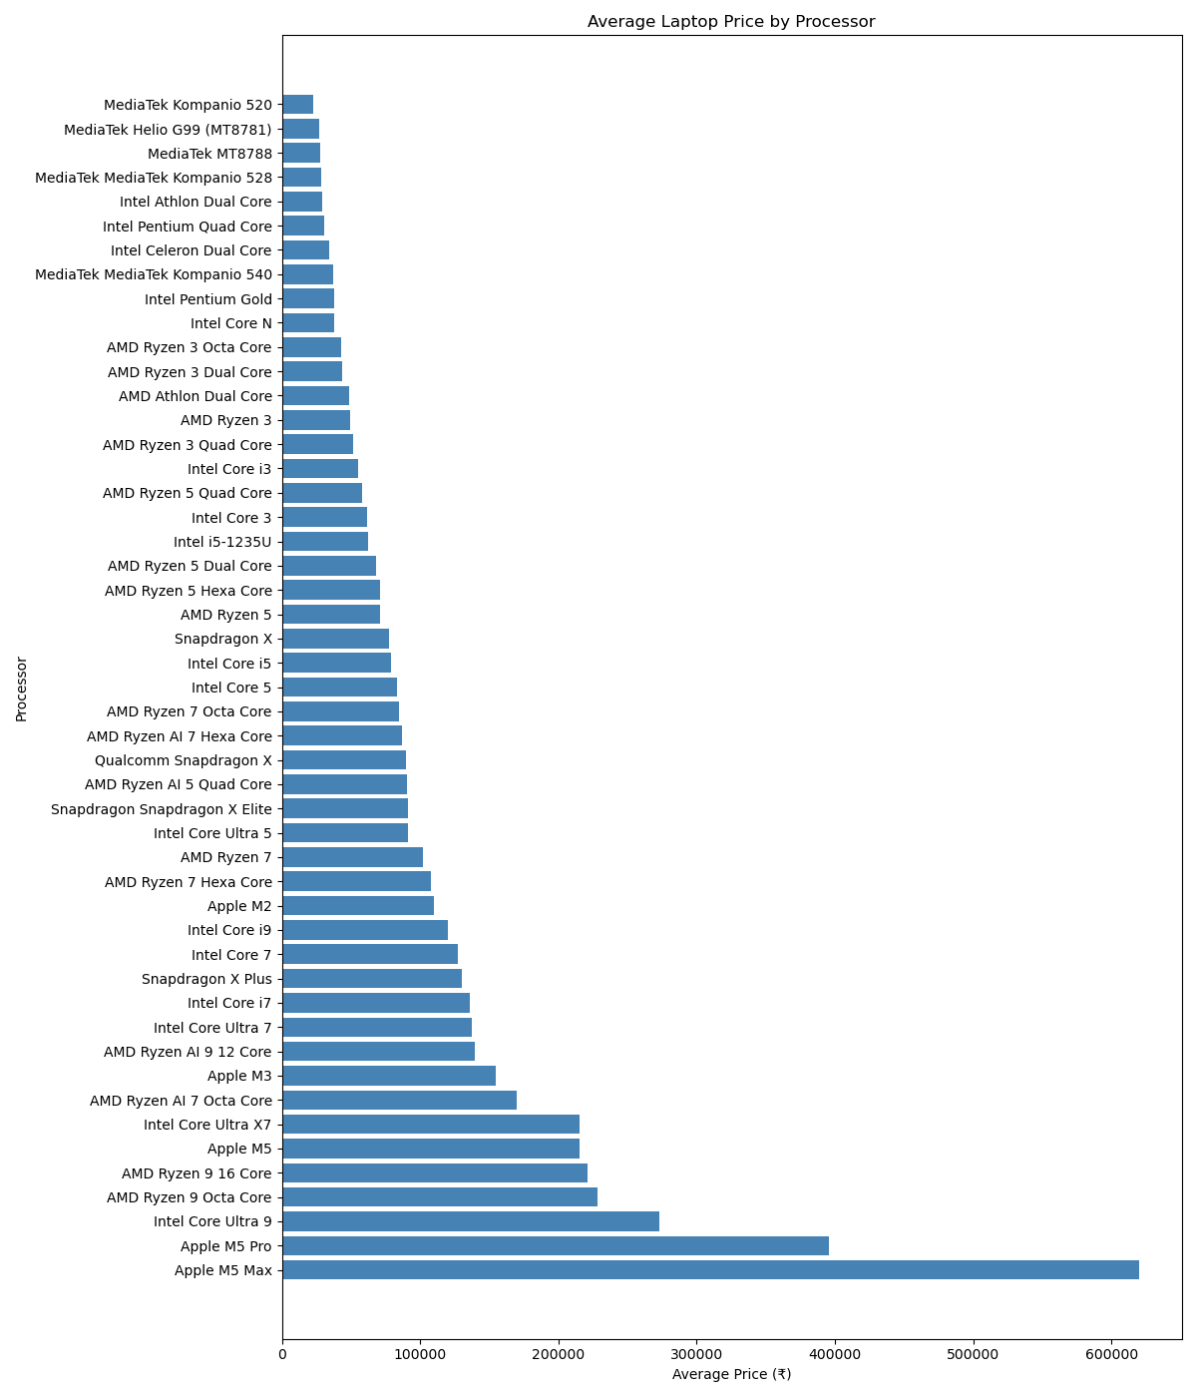
8. Average Price by Processor
Observation of 8: Premium processors such as Apple M5 Max, Apple M5 Pro, Intel Core Ultra 9, and AMD Ryzen 9 are associated with much higher average laptop prices, while entry-level processors such as MediaTek, Intel Celeron, and Intel Pentium have lower average prices.

Slide 21
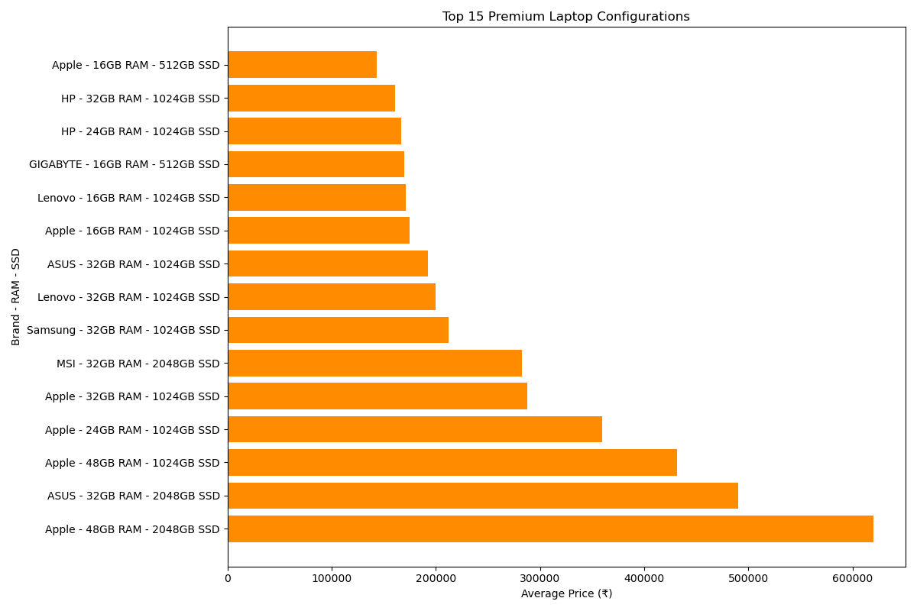
9. Top15 - Average Price by Brand, RAM and SSD
Observation of 9: Premium-priced laptops are generally associated with higher RAM and SSD configurations. Apple dominates the highest-priced combinations, while ASUS, MSI, Samsung, and Lenovo also appear among the higher-priced configurations.

Slide 22
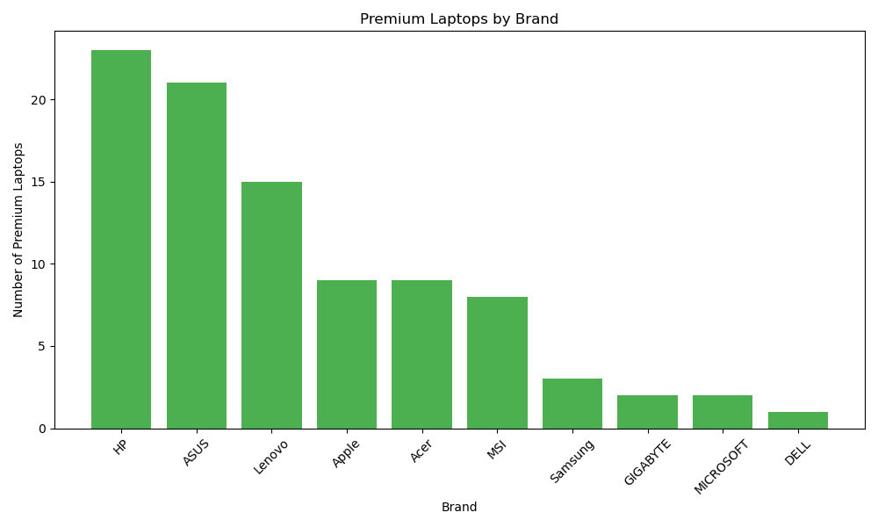
10. Premium Laptops Brand Distribution
Observation of 10: HP and ASUS have the largest number of premium laptops in the scraped dataset, while Lenovo also has a strong presence. Apple has fewer premium listings by count

Slide 23
Business Insights
ASUS, HP and Acer account for approximately 70% of the scraped listings, showing strong brand concentration.
Intel processors have a strong market presence, with Intel Core i5 being the most common processor.
8 GB and 16 GB RAM represent the mainstream configurations, with 16 GB leading.
512 GB SSD is the dominant storage configuration in the dataset.
Apple has strong premium price positioning with the highest average price.
Higher RAM configurations are generally associated with higher average prices.
Higher SSD capacities are generally associated with higher average prices.
HP, ASUS and Lenovo dominate premium listings by count, while Apple has stronger premium price positioning.

Slide 24
Recommendations
Prioritize 8 GB and 16 GB RAM laptops for mainstream customers.
Maintain strong inventory of 512 GB SSD laptops and offer 1 TB/2 TB as premium alternatives.
Maintain premium offerings from HP, ASUS and Lenovo while positioning Apple for higher-budget customers.
Use higher RAM and SSD configurations to create premium offerings and upselling opportunities.
Maintain a balanced portfolio covering high-demand mainstream brands and higher-specification premium models.

Slide 25
Conclusion
The cleaned dataset contains 550 unique laptop listings.
ASUS, HP and Acer dominate the scraped market by listing count.
16 GB RAM and 512 GB SSD are the most common configurations.
Brand, RAM, SSD and processor are strongly associated with differences in average laptop price.
Premium laptops represent 93 listings above ₹1,00,000.
The analysis provides a data-driven view of product availability, pricing and premium-market positioning.

Slide 26
Challenges
Handling missing values in scraped product attributes.
Removing duplicate product records across multiple scraped pages.
Extracting specifications from inconsistent text formats using Regular Expressions.
Handling SSD values recorded in both GB and TB.
Identifying and correcting unrealistic display-size values.
Interpreting statistical outliers without removing legitimate premium products.

Slide 27
Future Improvements
Scrape additional pages and more e-commerce platforms for broader market coverage.
Collect laptop GPU, operating system, warranty and battery information.
Standardize processor families for cleaner processor-level comparisons.
Track prices over time to analyze price changes and discount trends.
Build an interactive Power BI dashboard for dynamic business analysis.

Slide 28

THANK YOU

